Slide 1

Set your goal high and don’t stop and find your studi buddi
Study buddy Team

Slide 2
Who are we
We are LaGuardia Community College Students participating in Spring Hackathon

Slide 3

Our aims
To solve the problem faced by school students.

Slide 4
With Pandemic education patterns have changed and online education system is playing vital role in continuing education. With online education, students faces different challenges, and one such challenge is making friends. So, studi buddi is application to help the students to find friends who has same interest in subject, learn together and help each other to grow.

Slide 5
Dataset From New York CITY Open Data
link:https://data.cityofnewyork.us/Education/2018-2021-Daily-Attendance-by-School/xc44-2jrh

Slide 6
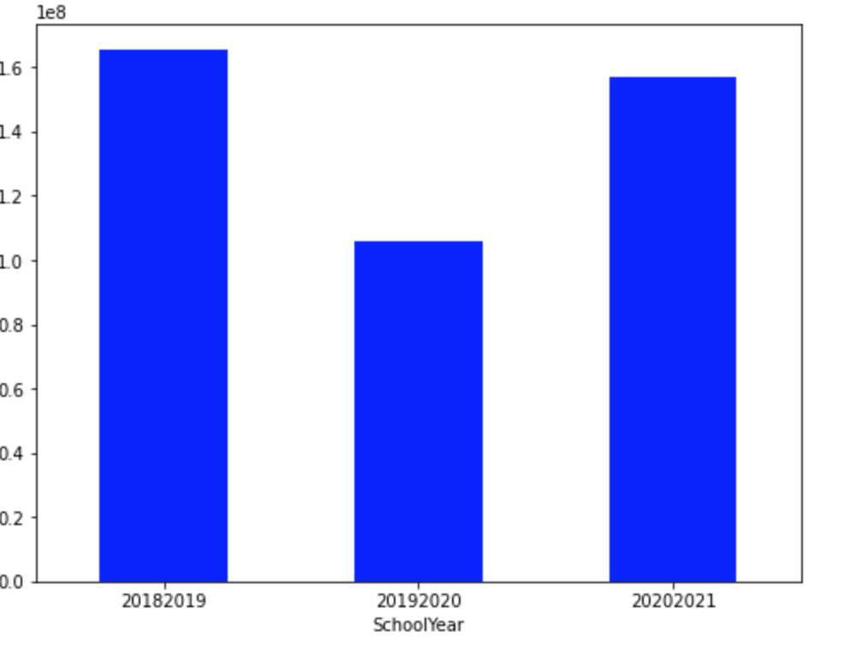
enrolled
2018-2019: 165 369 587
2019-2020: 105 961 354
2020-2021: 156 813 710

Slide 7
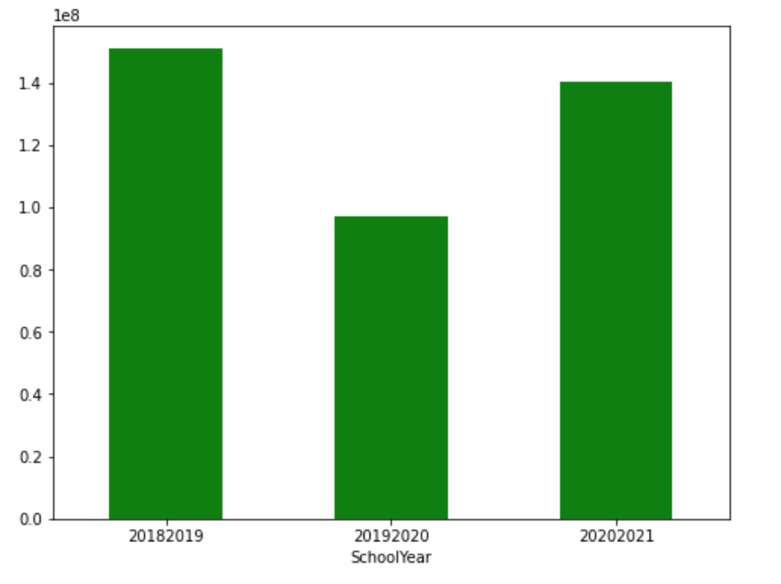
Present
2018-2019: 150 864 934
2019-2020: 96 931 536
2020-2021: 140 026 863

Slide 8
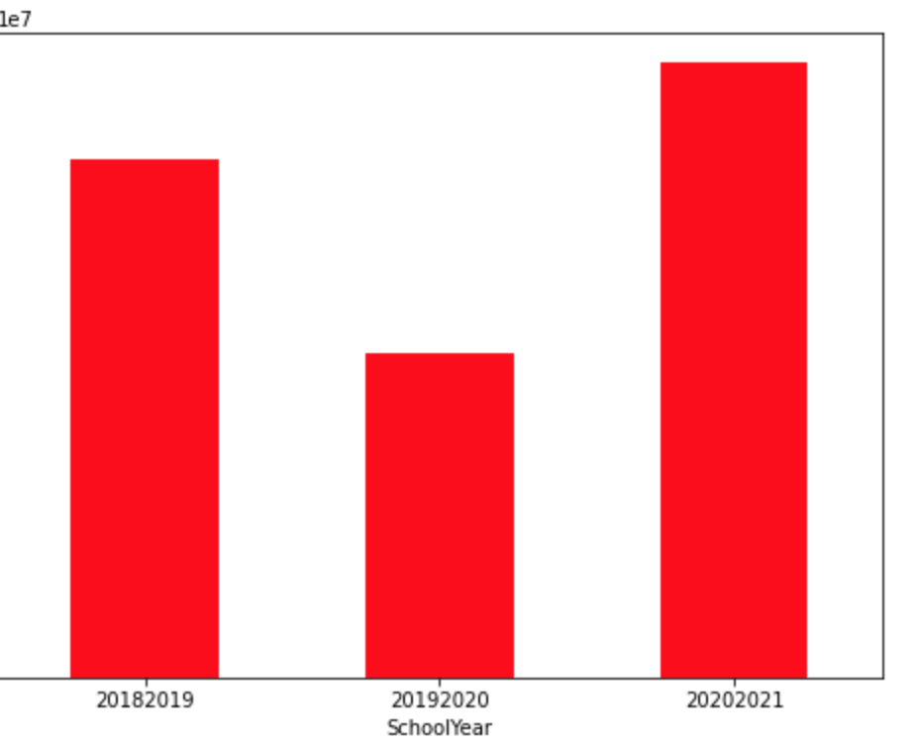
ABSENT
2018-2019: 13 959 193
2019-2020: 8 713 418
2020-2021: 16 538 118

Slide 9
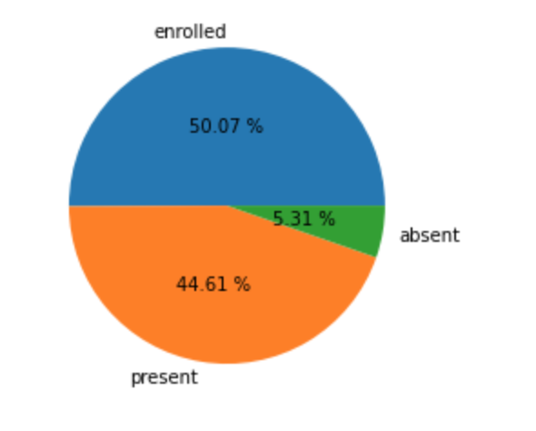
School attendance data

Slide 10
Data Analytics
So, from previous slide we can draw a conclusion that student present is less than student enrolled. There might be various reason for absence but the no. of absent is at very high numbers. Let's see for example in 2018-2019: 165 369 587 students were enrolled in school and these students 150 864 934 were present and these student were absent 13 959 193.
Thirteen Millions is huge number and studi buddi application is targeting these student who were absent to catch up on their studies. This application can help in various ways, but ultimatum goal of application is finding a friend for studying and help each other grow.

Slide 11
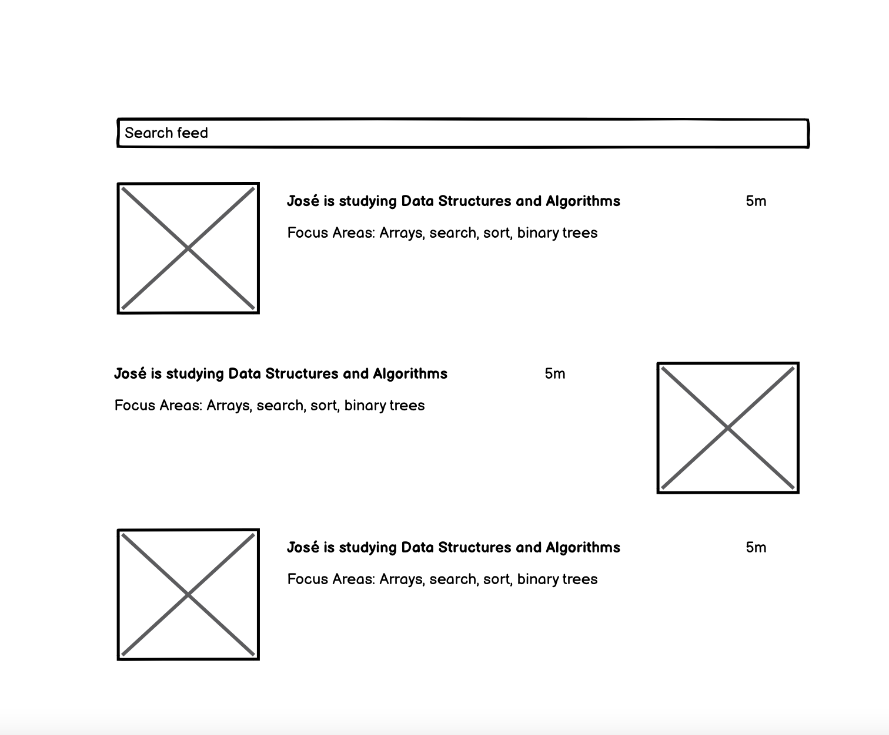

Slide 12
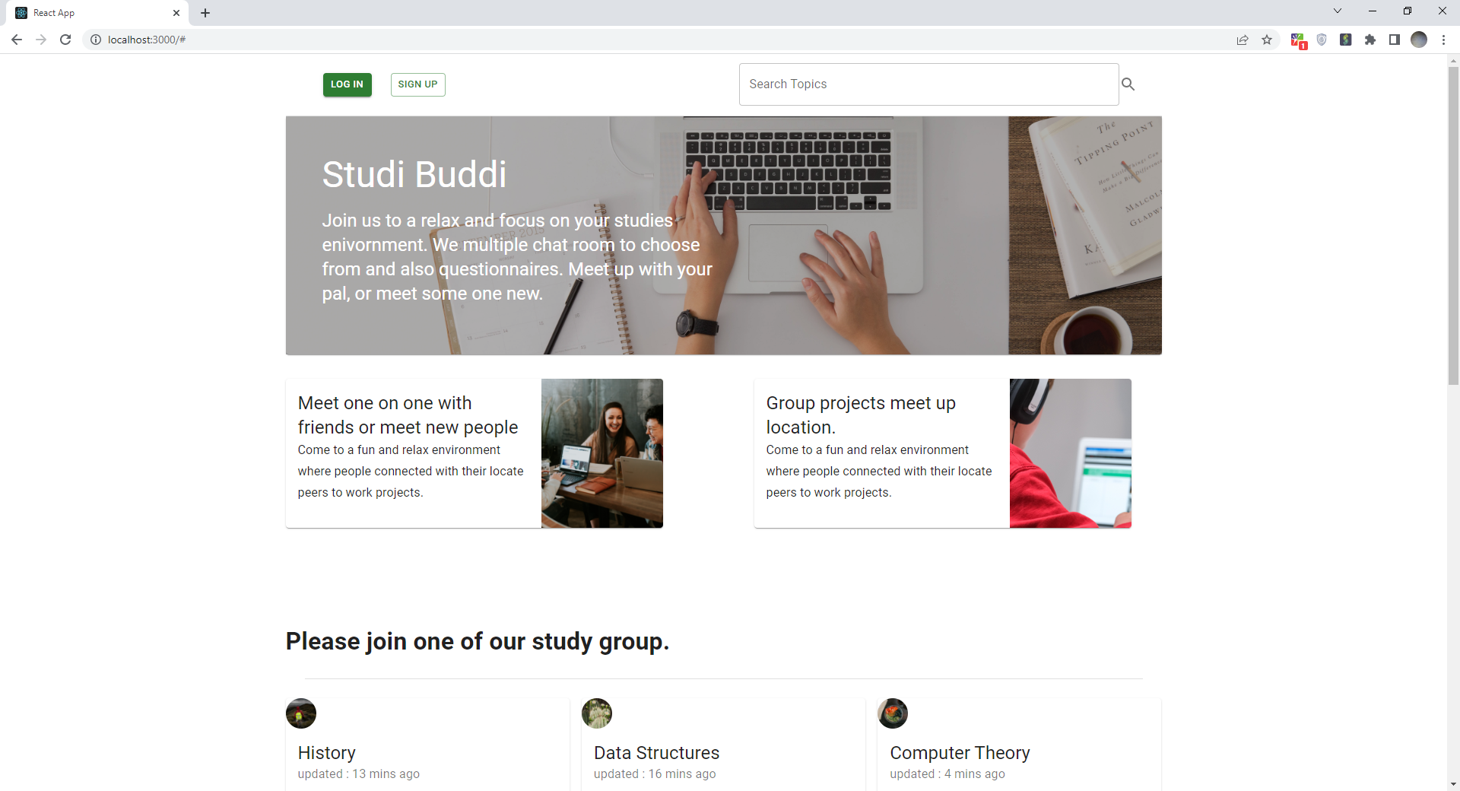
https://github.com/lauchRocke/studiBuddi.git

Slide 13
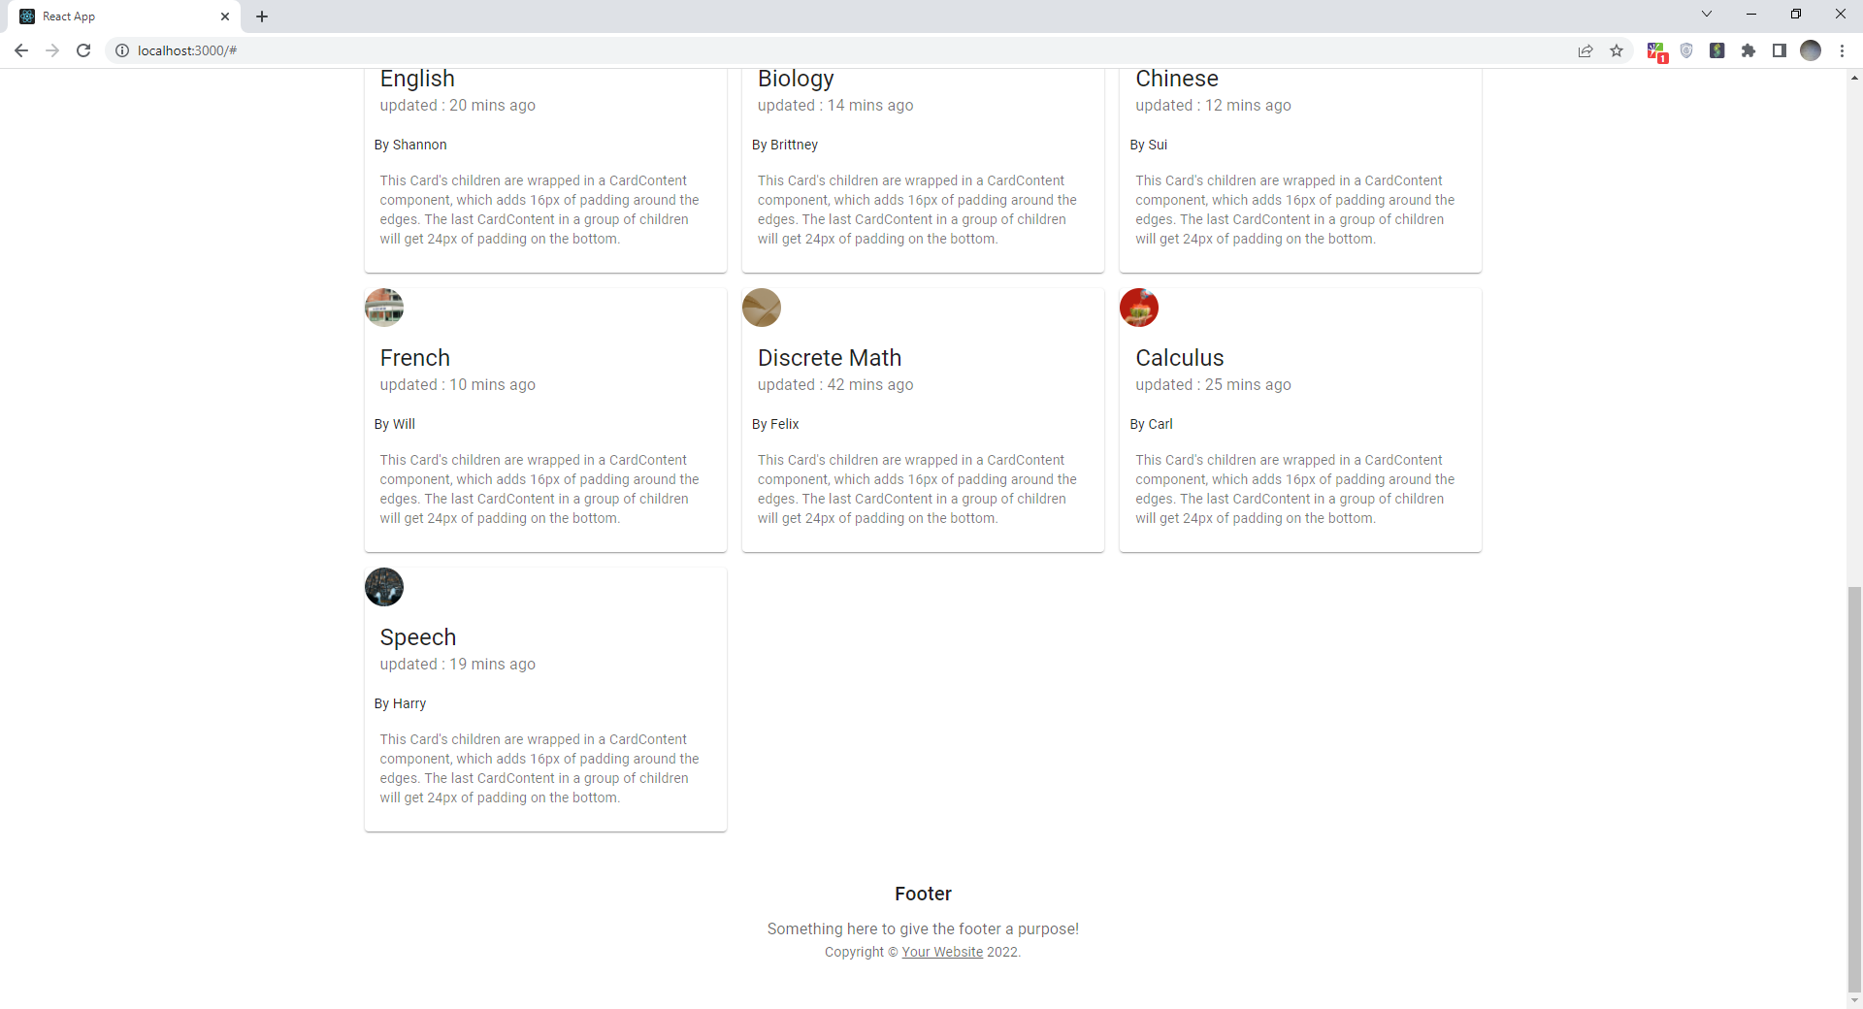

Slide 14
Test Case ID: Studi BudDi
Test Description: when using the application there is the search button in the head of the page and When entering the name of the course, list of courses will be shown up and a list of people who are registered and online at that time.
Test Case Type:
Functionally: Area should accommodate up to 35 characters
Test Step: input 35 characters
Expected Result: All the 35 characters should be appropriate
Status: Found a result of the search or not Found
Security: Verify username and password rules are working
Test Step: create a password accordance to the rules
Expected result: the User password will be accepted if it adheres with the res, and a verifying email with a code will be sent to the user email.
Status: pass or fail
Usability: ensure all Icons are connected and working properly
Test Step: Have the user on various Icons on the app.
Expected Result: Icons will take the users to another page with different steps they can as well click the home Icon to get back to homepage and start over.
Status: pass or fail

Slide 15
Conclusion
With online education it is hard to make a friend. Every student pace of studying and understanding level is different so, studi buddi application is trying to solve students' problem by finding friends who has common goal and connect with it.
Also, studi buddi application is looking further to expand into finding people who have same interest to come together and set a target date to achieve goal together.
Have a library on its platform.
Have feedback section to improve the application further.

